Slide 1
CAPSTONE PROJECT - STORY TELLING
WEB AND SOCIAL MEDIA ANALYSIS
- BY DARSHANA SINGH, SHRADDHA MALI & PALASH WANWANI

Slide 2
AGENDA
01
04
INTRODUCTION
RECOMMENDATIONS
05
02
PROBLEM STATEMENT &
OBJECTIVES
APPENDIX
03
EXPLORATORY DATA ANALYSIS

Slide 3
In an era of rapid digitization and widespread mobile phone and internet access, consumer opinions have become invaluable assets for product-based companies, particularly those in the B2C sector.
As mobile phones and internet access become ubiquitous, consumer opinions hold increasing value for B2C companies. In e-commerce, where physical product experiences are impossible, customers rely heavily on online reviews to guide their purchase decisions. However, sorting through numerous text reviews can be overwhelming. To simplify this, a more efficient numerical rating system based on review analysis can help streamline the decision-making process, making it easier for consumers to choose the right products.
INTRODUCTION
WEB AND SOCIAL MEDIA ANALYSIS

Slide 4

PROBLEM STATEMENT
As a new entrant in the U.S. mobile phone market, the company needs to leverage insights from customer reviews to better understand user preferences and improve its product offerings. Key challenges include:
Customer Sentiment:
Analyzing reviews to identify what features users value most and what drives dissatisfaction.
Product Optimization:
Using review data to guide product development, ensuring features align with customer expectations and needs.
Market Strategy Enhancement:
Develop data-driven marketing strategies by analyzing customer reviews to highlight strengths, address pain points, and tailor messaging, improving brand perception and increasing customer satisfaction and market share.

Slide 5

OBJECTIVES
Conduct in-depth market research to understand current trends, consumer preferences & competitor offering.
Identify gaps in the market and pinpoint specific needs that a new product can address with their specific needs and preferences.
Provide major insights into the cell phone industry to help them develop a new product & tailoring its features, marketing messages, and distribution channels optimally.
To tweak the marketing strategies in order to add more value to the product and close the supply-demand gap.

Slide 6
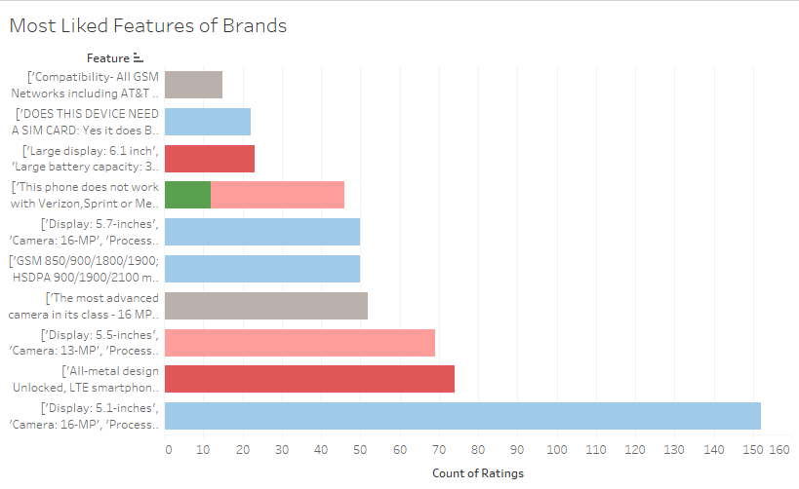
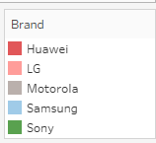
Exploratory Data Analysis (EDA)
Most liked Features of Brands

Slide 7
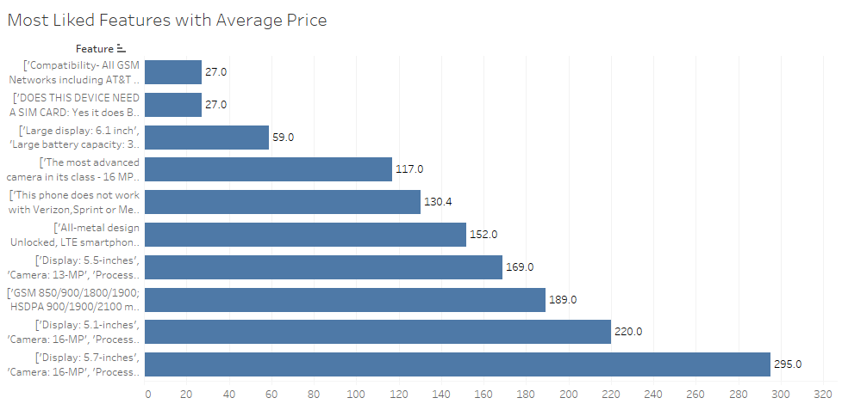
Exploratory Data Analysis (EDA)
Most liked Features of Brands with Average Price

Slide 8
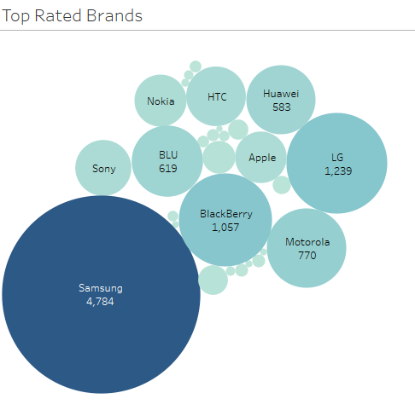
Review Sentimental Analysis
Exploratory Data Analysis (EDA)
Top Rated Brands: The chart highlights Samsung as the highest-rated brand, significantly leading with 4,784 ratings, followed by LG, BlackBerry, and Apple, indicating their strong
customer satisfaction.
Market Positioning: Brands like Samsung and LG dominate customer ratings, suggesting a higher level of user satisfaction, while smaller brands like BLU and Huawei have relatively fewer ratings, reflecting either niche markets or lower customer
engagement.
Top Rated Brands

Slide 9
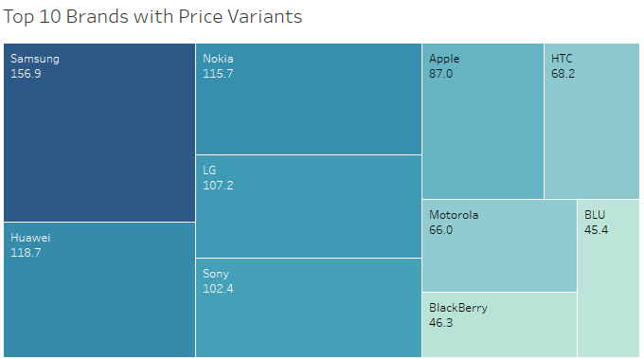
Exploratory Data Analysis (EDA)
Brand Price Variations: The treemap shows Samsung, Nokia, and Huawei leading in price variants, indicating a wide product range across different price points.
Market Insights: Higher price variants reflect brands like Samsung & Apple targeting premium customers, while others like BLU cater to budget-conscious buyers.
Treemap showing Top 10 Brands with price variants

Slide 10
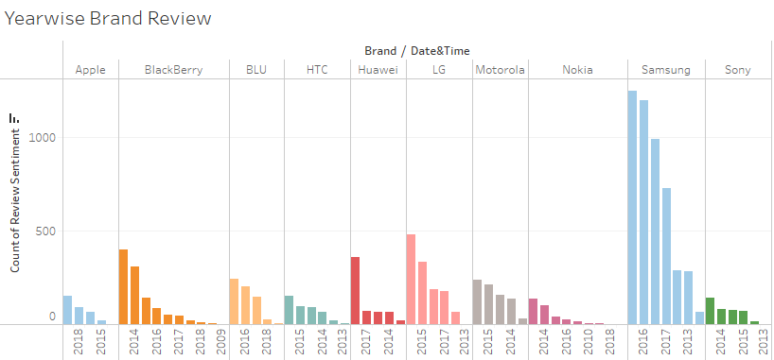
Exploratory Data Analysis (EDA)
Top 10 brand Yearly Review Stats

Slide 11
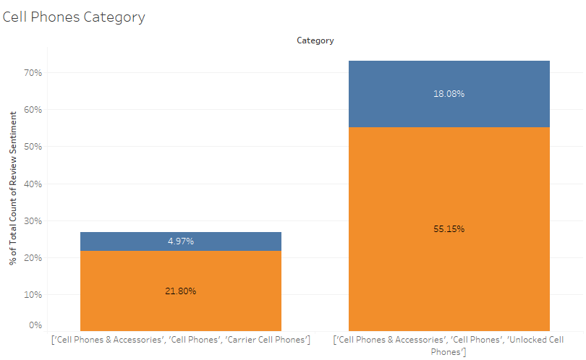
Exploratory Data Analysis (EDA)
Unlocked phones dominate: The category including unlocked phones represents over 73% of the market, indicating strong consumer preference for non-carrier-locked devices.
Accessories matter: "Cell Phones & Accessories" appears in both categories, suggesting accessories play a significant role in the overall cell phone market.
Positive v/s Negative Review

Slide 12
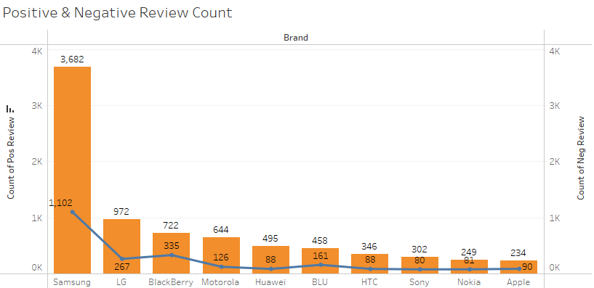
Exploratory Data Analysis (EDA)
Brand popularity comparison: Samsung clearly dominates in terms of total reviews, with 3,682 positive and 1,102 negative reviews.
Positive-to-negative ratio: Apple, despite having the fewest total reviews, has the most favorable ratio of positive to negative reviews (234 positive vs. 90 negative).
Review Sentimental Analysis

Slide 13

RECOMMENDATIONS
By analysing the sentiment of the reviews, it is understood that features incorporated by major brands should be included in developing a new product.
Ensure essential features like battery life, camera quality, performance speed, and durability meet or exceed customer expectations, as these are top priorities in user reviews.
Offer competitive pricing with good value for money. Balance advanced features with affordability to attract budget-conscious customers without compromising on quality.
Build a strong brand presence on social media and e-commerce platforms, engaging with customers, responding to feedback, and providing transparent product information.
Also OS Android holds the major share of the market. This should be not ignored while designing the new products. Style adds more attraction to the product. Hence, a style and design would do great.

Slide 14
THANK YOU

Slide 15
APPENDIX

Slide 16
DATA PRE-PROCESSING
unixReviewTime was converted to datetime format
5
4
3
Merging Phone Data & Metadata
Text Analytics
2
1
Dropping Null values in phone data
Selecting Required data from meta data

Slide 17
TEXT ANALYTICS
Since, text is the most unstructured form of all the available data, various types of noise are present in it and the data is not readily analyzable without any pre-processing. The entire process of cleaning and standardization of text, making it noise-free and ready for analysis is known as text preprocessing. In this section, the following text preprocessing were applied:
Cleaning Text: Special characters, unnecessary single characters, and multiple spaces were removed to reduce noise and ensure cleaner text data.
Standardizing Case: All reviews were converted to lowercase, ensuring consistency and preventing case sensitivity from impacting the analysis.
Processed Review Storage: Cleaned reviews were stored in a list for further analysis, such as sentiment extraction or feature identification.
Removing stopwords: Stopwords are words that have little or no significance. They are usually removed from text during processing so as to retain words having maximum significance and context. Here we have used given text file to remove sop words.

Slide 18
MACHINE LEARNING MODEL
In this analytics project,the model needs to predict sentiment based on the reviews written by customers who bought phones.
This is a supervised binary classification problem. We have used Naive Bayes machine learning algorithms for modelling after splitting the train & test data.
Naive Bayes implements the naive Bayes algorithm for multinomial distributed data, and is one of the two classic naive Bayes variants used in text classification (where the data are typically represented as word vector counts). This algorithm is a special case of the popular naïve Bayes algorithm, which is used specifically for prediction and classification tasks where we have more than two classes.

Slide 19
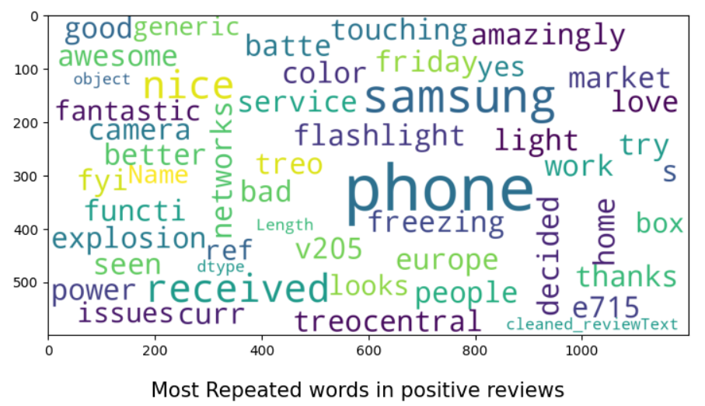
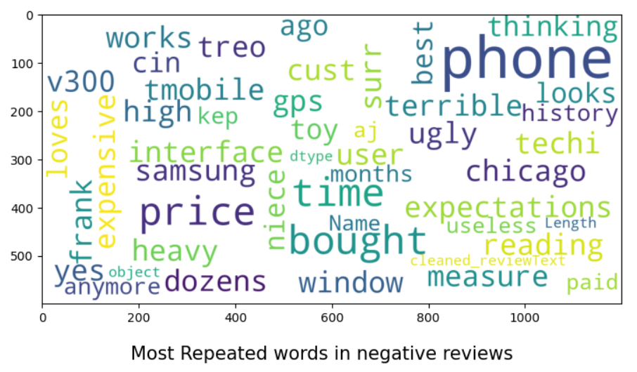
WORDS USED IN THE REVIEW
We used the stopwords & removed extra words and punctuation marks from the reviews added by the consumers.
Find on the left hand side, the most repetitive words across the datasets in both positive as well as negative reviews.

Slide 20
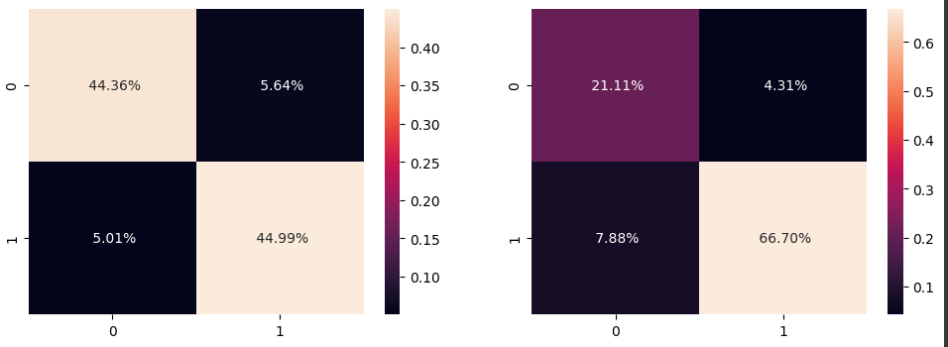
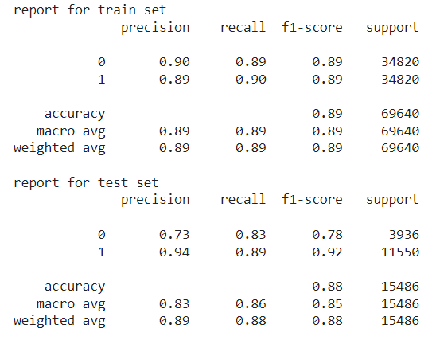
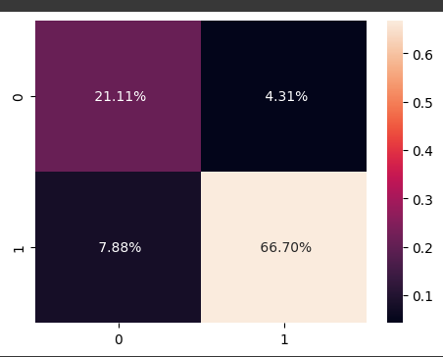
CONFUSION MATRIX
We got a really good score from the model created based on the train & test data.
Below are are accuracy score for the train data as well as the test data

